Slide 1

KELLOGG’S ASSESSMENT
UTPAL MISHRA

Slide 2

PRODUCT SALES FORECASTING
PS: Your stakeholders are keen to understand which customers are not likely to purchase a ‘K’ product within the next 3-months. They would like you to be able to predict the likelihood that this occurs, given a customer has purchased a ‘K’ product within the past 9-months.

Slide 3
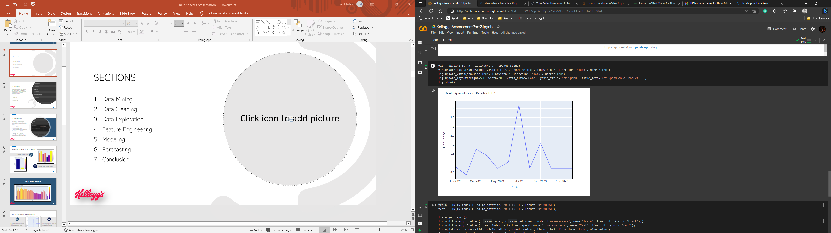
SECTIONS
Data Mining
Data Cleaning
Data Exploration
Feature Engineering
Modeling
Forecasting
Conclusion

Slide 4
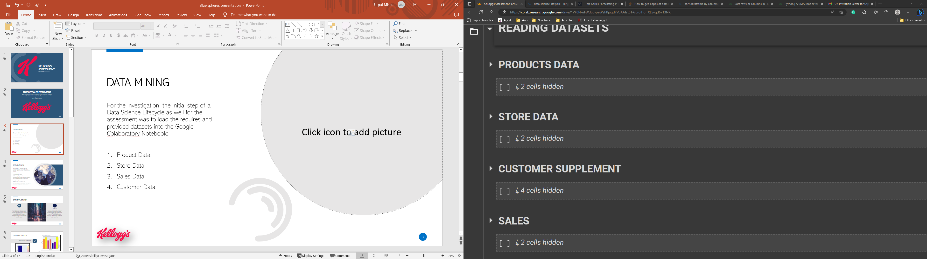
DATA mining
For the investigation, the initial step of a Data Science Lifecycle as well for the assessment was to load the requires and provided datasets into the Google Colaboratory Notebook:
Product Data
Store Data
Sales Data
Customer Data

Slide 5
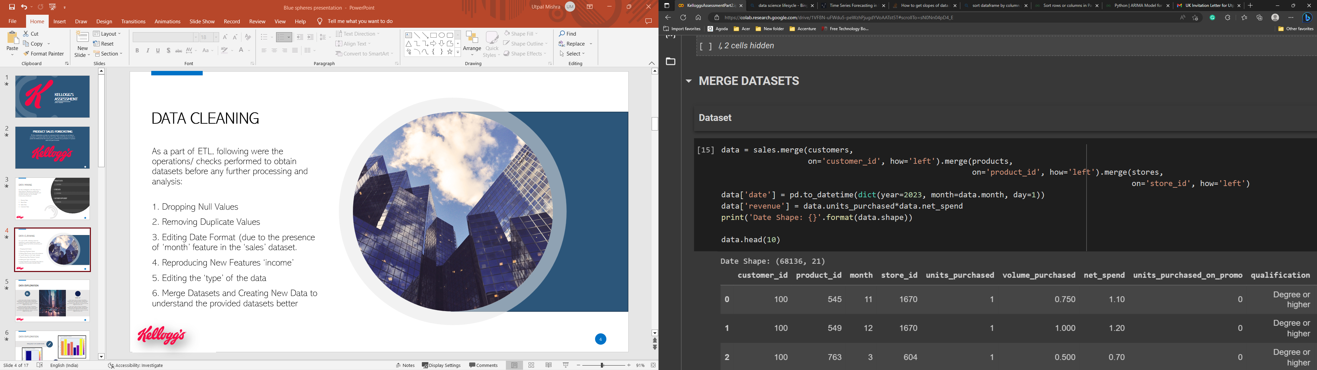
Data Cleaning
As a part of ETL, following were the operations/ checks performed to obtain datasets before any further processing and analysis:
1. Dropping Null Values
2. Removing Duplicate Values
3. Editing Date Format (due to the presence of ‘month’ feature in the ‘sales’ dataset.
4. Reproducing New Features ‘income’
5. Editing the ‘type’ of the data
6. Merge Datasets and Creating New Data to understand the provided datasets better

Slide 6
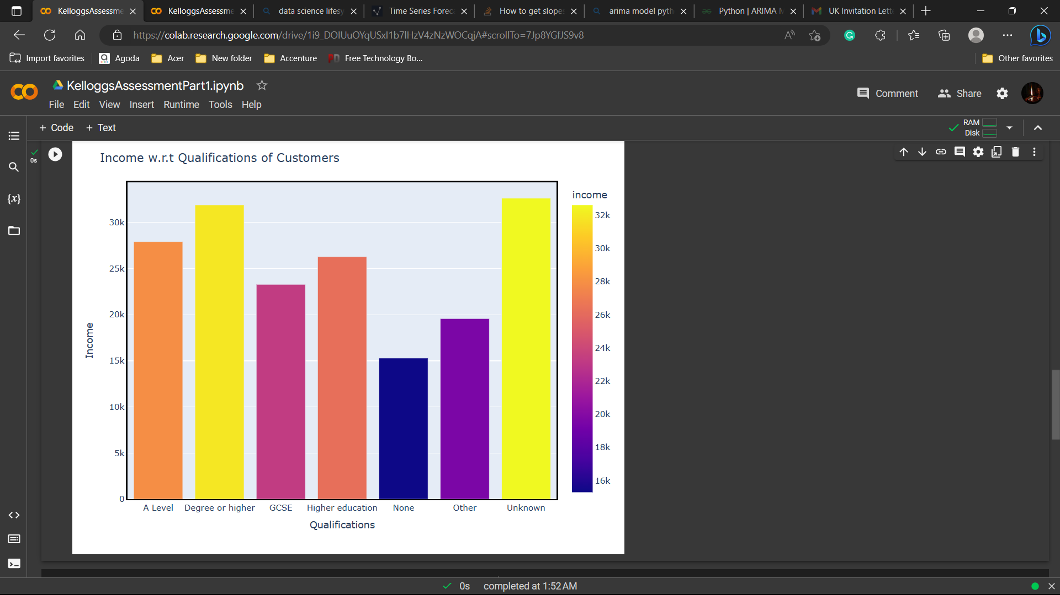

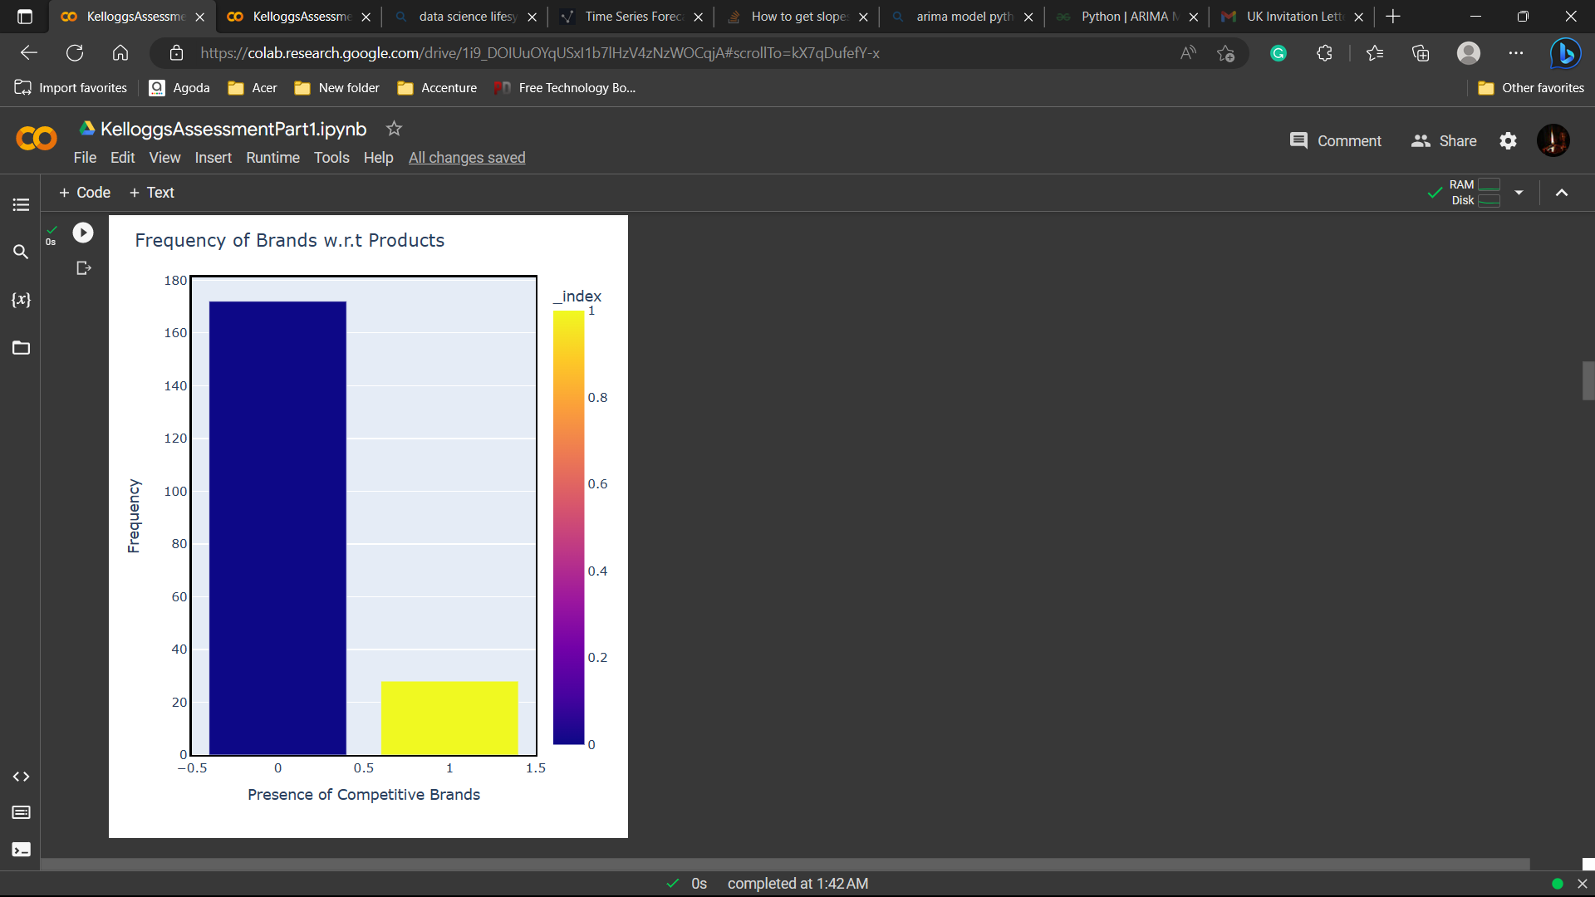

DATA EXPLORATION & VISUALIZATION
Frequency of competitors
Customer INCOME VS qualifications

Slide 7
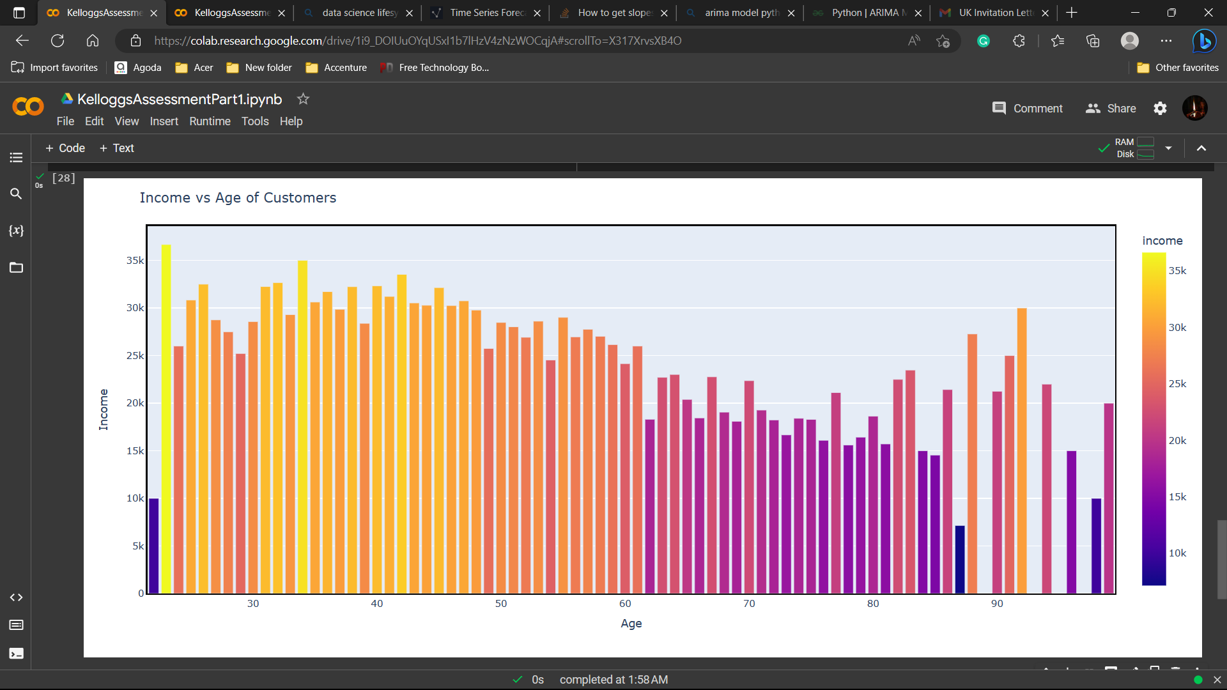
DATA EXPLORATION & VISUALIZATION

Slide 8
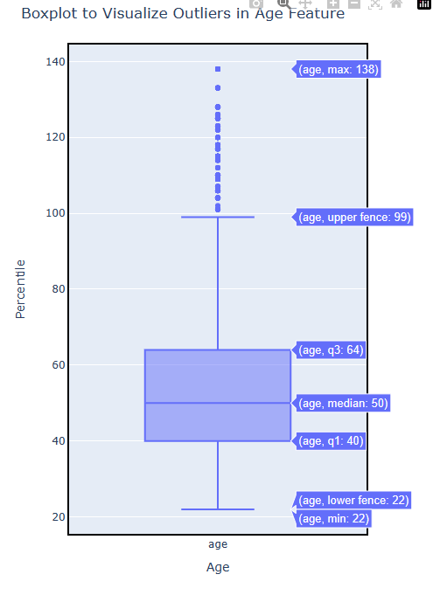


DATA EXPLORATION & VISUALIZATION
As can be intercepted from the presented graph, there exist outlier for the Customers above the age of 100 and certainly inter-quantile distance for the ‘age’ feature..
To remove the outliers, the datasets was filter for age categories under 100 to simplify the possibilities for data analysis with respect to age categories.

Slide 9
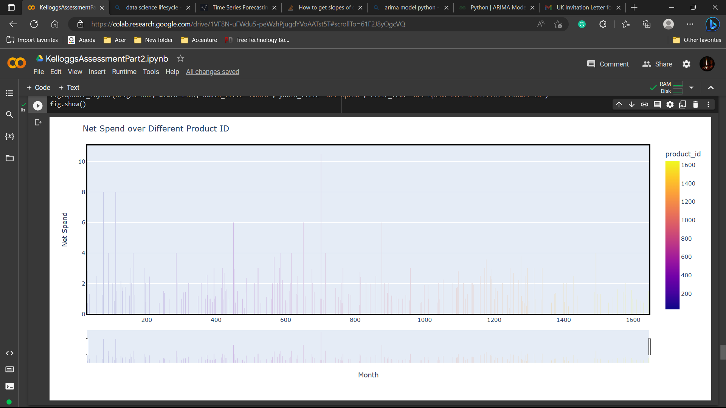
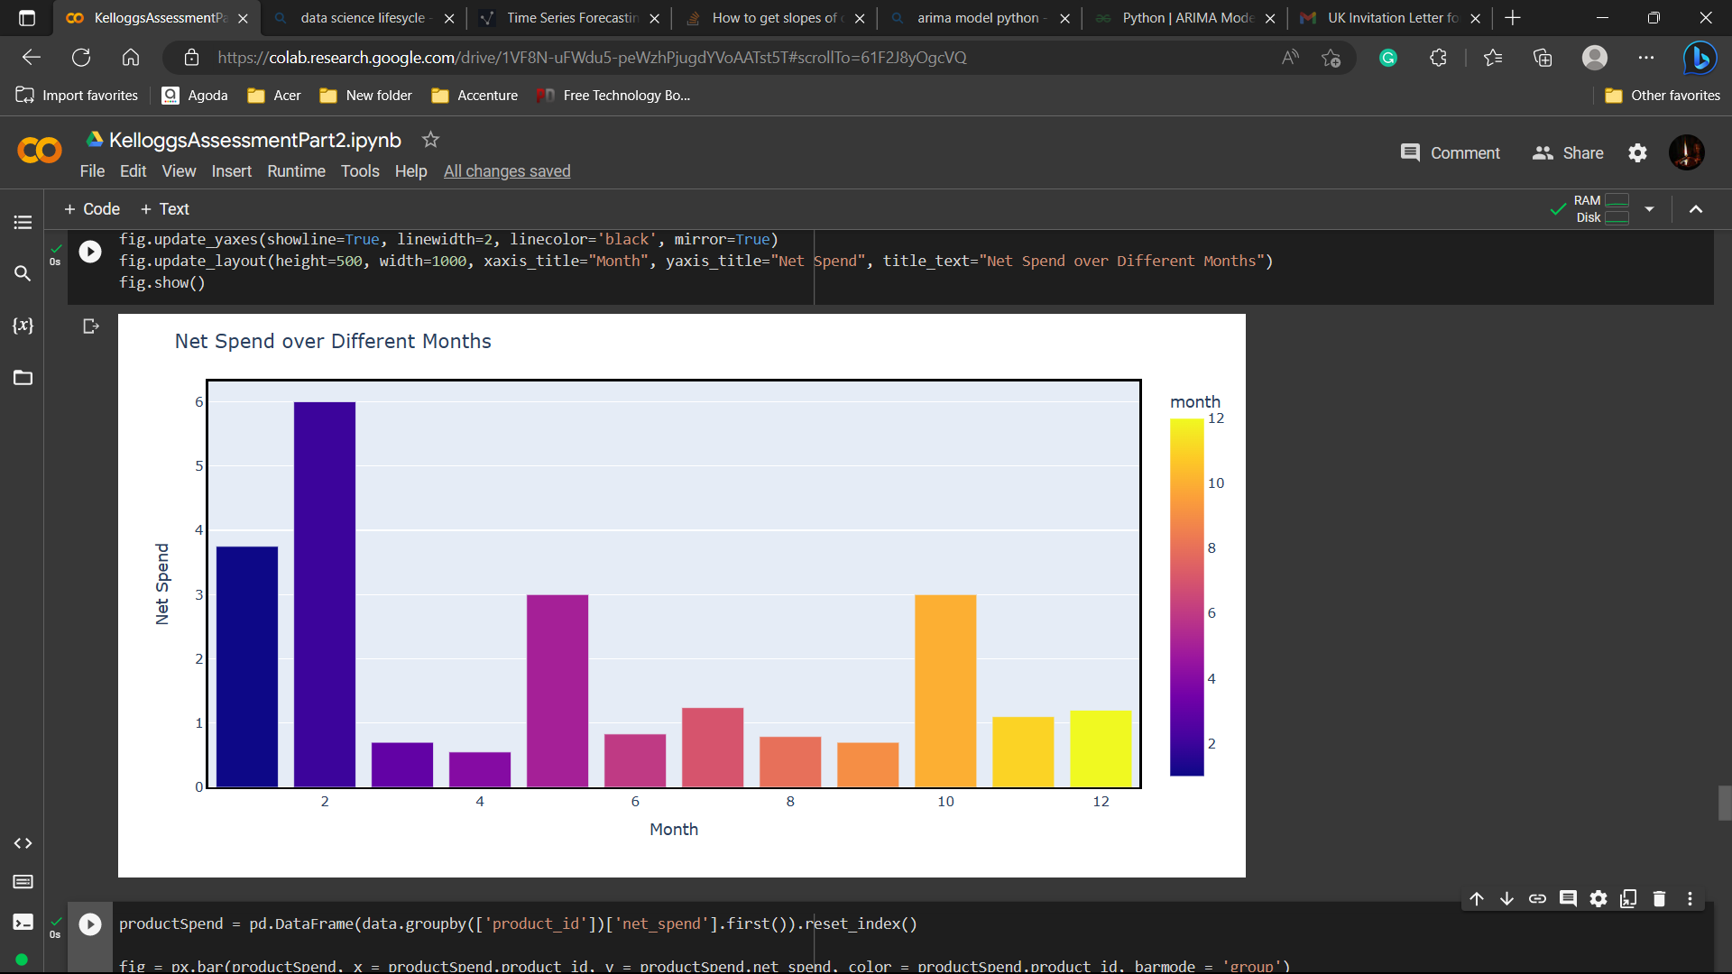
DATA EXPLORATION & VISUALIZATION
Net spend w.r.t months
Net spend w.r.t product id’s

Slide 10
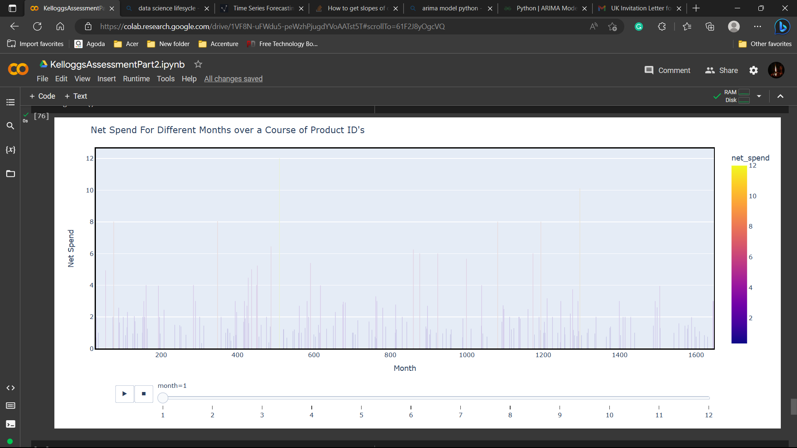
DATA EXPLORATION & VISUALIZATION

Slide 11
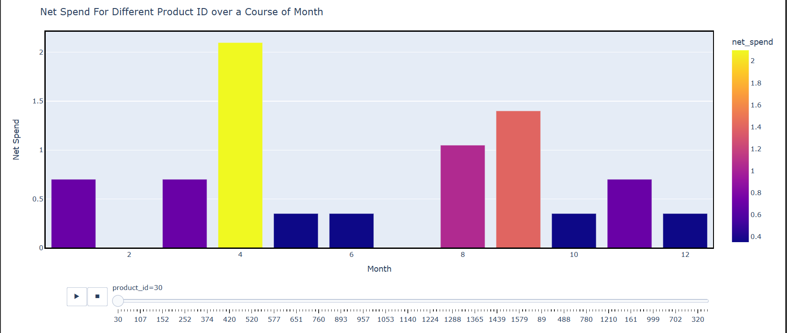
DATA EXPLORATION & VISUALIZATION

Slide 12
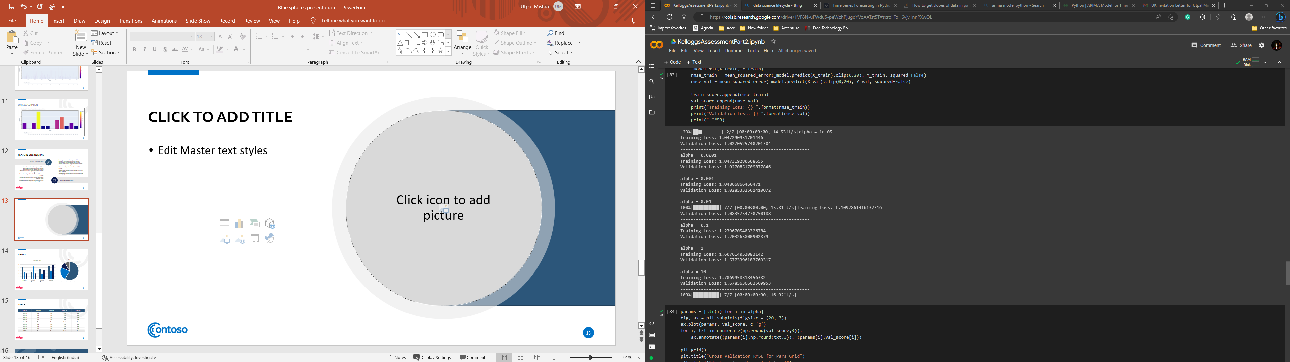
Feature engineering
In order to prepare the data for Machine Learning modelling, the data was extracted from a merged dataset comprising the data from ‘sales’ and ‘product’ so, we can build a model trained on the sales done for different products.

Slide 13
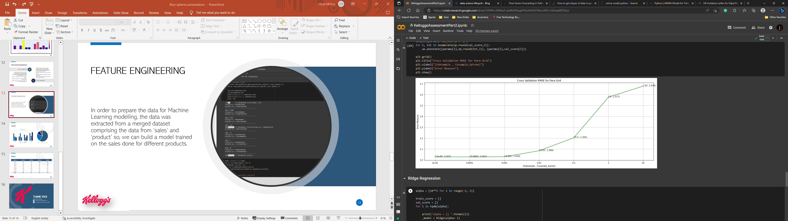
MODELING
For building a data model, the dataset was split into sets of train, validation and test in a ratio of 70:20:10.
Prior to the splitting, the model was testing on two regression models namely, Lasso Regression and Ridge Regression using Cross-Validation.
Being regression models, the metrics used were Root Mean Squared Error, which was found to be 1.679 and 1.212, respectively.

Slide 14
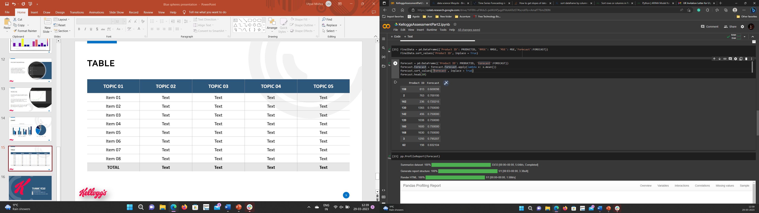
FORECASTING
In order to answer the question of the assessment, forecasting was performed on the data comprising ‘product_id’ and ‘net_spend’. For forecasting, ARIMA Model was used and models were build with respect to the slope of the lines found when processed with a Product ID and it’s respective Net Spend for over a Year.

Slide 15
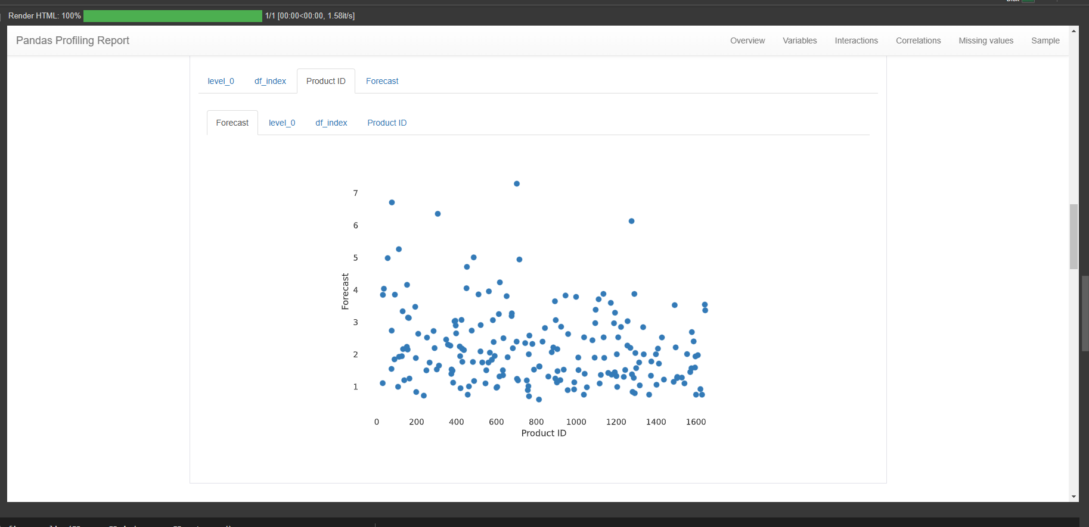
forecasting

Slide 16
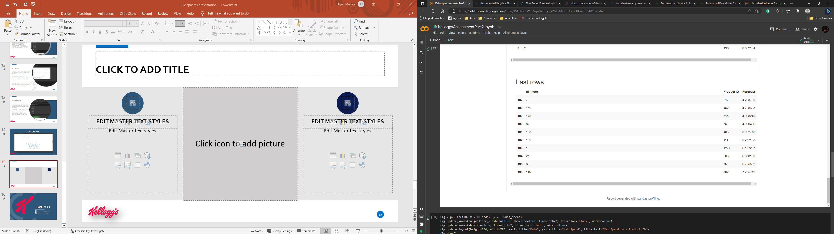
CONCLUSION
For the datasets provided on product sales, it was observed that the top 10 product were forecasted to have a Net Spend of almost one-fourth of the average of the Net Spend on all the products.
Additionally, Product ID such as 198, 1293 and 1630 were expected to have the highest Net Spend.
On parts of improvement: 1. For Data Cleaning, Data Imputation could be used.
2. For Model Building, Different ML Models could be used such LSTM.
3. For Forecasting, different Time Series Model could be used with different set of features to test in an attempt to build a higher correlation between the attributes.

Slide 17
Thank you!
utpalmishra21official@gmail.com
https://www.linkedin.com/in/utpal-mishra

